Slide 1
ONLINE COURSES USERS
B.Leenasri Reddy
Source: https://www.kaggle.com/datasets/khaledatef1/online-courses
Dataset: Online Courses users
Email: leenasrireddy2004@gmail.com
Phone:7569666140
GitHub: https://github.com/leenasrir29/BigDataAnalytics
LinkedIn:https://www.linkedin.com/in/leenasri-reddy-basireddy-gari-675570302/

Slide 2
Introduction
Online education has become a mainstream mode of learning across diverse subjects and skill levels.
Understanding user behavior, learning patterns, and course engagement is critical for improving the effectiveness of online learning.
Learners today interact with platforms in varied ways—some complete entire courses, while others drop off eay or only consume specific modules.
Factors like course duration, content quality, platform features, and learner motivation significantly influence engagement.
Analyzing engagement trends helps:
Improve course structure and pacing
Enhance learner retention and satisfaction
Personalize learning paths based on user needs

Slide 3
Dataset Description
Source: online courses.csv
Records: 10,000 records | Columns:7
Columns Overview:
Course Id:Course id of the dataset.
Course Name: Name of the course
Category: The category of the online users.
Duration: Course Duration.
Platform: Name of the platform
Rating:The rating of online courses.

Slide 4
Data Quality
Completeness:
No missing or null values across all fields.
All records include essential attributes such as course name, duration, platform, and completion rate.
Uniqueness:
All Course_IDs are unique, ensuring no duplicate course records.
Consistency:
Standardized formats across:
Categories (e.g., "Technology", "Business", etc.)
Duration in hours (numerical)
Prices in USD
Ratings on a 0–5 scale
Accuracy:
Logical value ranges:
Completion Rate: 0% – 100%
Rating: 0.0 – 5.0
Duration: 0.5 – 100+ hours

Slide 5
Data Exploration & Operations
1. Data Cleaning
Verified all columns for non-null values.
Removed duplicate records to ensure data integrity.
Standardized data types (e.g., numeric for ratings and completion %, categorical for platform and category).
Validated value ranges for numerical fields:
Ratings: 0–5
Completion Rate: 0–100%
Duration: >0 hours
2. Summary Statistics
Computed basic descriptive statistics:
Mean, Median, Standard Deviation for:
Course Duration
Enrolled Students
Ratings
Completion Rates
Identified distribution patterns for engagement metrics.
3. Visual Exploratory Analysis
Bar Chart: Number of courses by category.
Pie Chart: Distribution of engagement grades (e.g., A+, A, B...).
Histogram: Spread of course durations.
Box Plot: Comparison of ratings and completion rates by category.
Scatter Plot: Relationship between duration and completion rate (engagement indicator)

Slide 6
Methodolgy / workflow
1. Data Collection
Collected a comprehensive dataset of 10,000 online courses from multiple popular e-learning platforms (e.g., Coursera, Udemy, edX).
Dataset includes course attributes such as course ID, name, category, duration, enrollment, completion rate, platform, price, and ratings.
2. Data Cleaning
Checked for and removed duplicates to maintain data integrity.
Verified and handled missing or inconsistent values (none found in this dataset).
Standardized data formats across all fields (numerical, categorical).
Ensured unique identifiers for each course.
3. Data Exploration & Analysis
Conducted descriptive statistics to summarize key variables (mean, median, standard deviation).
Explored distribution and variation in course durations, ratings, completion rates, and enrollments.
Created visualizations to understand relationships and trends:
Bar charts, pie charts, histograms, box plots, scatter plots.
4. Insights & Interpretation
Analyzed engagement patterns across course categories and platforms.
Examined correlations between course duration, completion rates, and ratings.
Identified skill-level trends and learner proficiency.
Derived actionable recommendations based on observed data patterns.
5. Future Steps
Suggest applying predictive modeling techniques to forecast learner engagement and dropout.
Recommend clustering analysis to identify user segments for personalized learning paths.

Slide 7
Key Insights
Course Engagement Patterns
Average course completion rate is around 60%.
Technology and Data Science courses lead in both enrollment and engagement.
Courses with duration over 18 hours tend to have higher completion rates and ratings.
2. Platform-Level Insights
Coursera and edX offer longer, higher-rated courses.
Udemy has the largest student enrollment but slightly lower average completion rates.
3. Category-Specific Trends
Technology and Data Science show high engagement grades (A+/A).
Office Tools and Business courses have moderate completion (~50%).
Niche subjects reveal wide variability in duration and learner ratings.

Slide 8
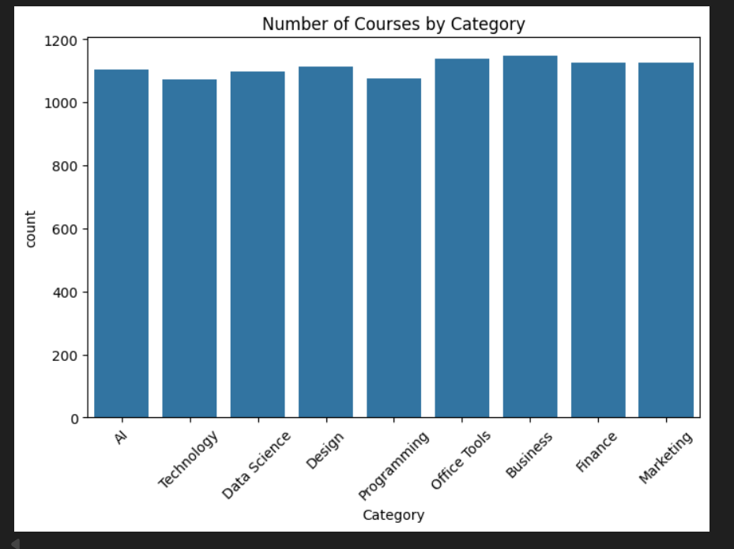

Slide 9
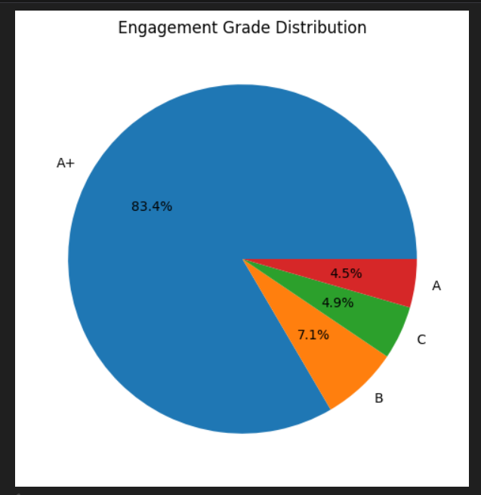
Engagement Grade Distribution
A+: 83.4%
A: 4.5%
B: 4.9%
C:7.1%

Slide 10
Recommendations
1.Enhance Learner Engagement
2. Platform-Specific Strategies
3. Focus on Skill Development
4.Data-Driven Interventions
Future Analytics Opportunities
Predictive Modeling
Learner Segmentation

Slide 11
Conclusion
Technology and Data Science courses lead in both popularity and learner completion.
Course duration and user ratings significantly impact learner engagement and retention.
Platforms show distinct strengths and areas for improvement, with Udemy needing focus on completion rates.
Data-driven strategies like modular courses, gamification, and personalized learning paths enhance learner success.
Future analytics (predictive modeling, segmentation) can help reduce dropouts and tailor learning experiences.
Applying these insights is vital to optimize online education and promote sustained user growth.

